Slide 1

Introduction_Lab01

Slide 2
An example: DNS
Domain name system on the blockchain: [google.com ⇾ IP addr]
Need support for three operations:
Name.new(OwnerAddr, DomainName): intent to register
Name.update(DomainName, newVal, newOwner, OwnerSig)
Name.lookup(DomainName)
Note: also need to ensure no front-running on Name.new()
Courtesy Prof. Dan Boneh

Slide 3
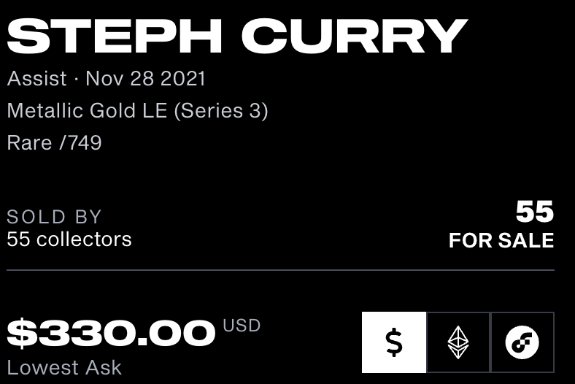



Ethereum: enables a world of applications
A world of Ethereum Decentralized apps (DAPPs)
New coins: ERC-20 standard interface
DeFi: exchanges, lending, stablecoins, derivatives, etc.
Insurance
DAOs: decentralized organizations
NFTs: Managing asset ownership (ERC-721 interface)
stateofthedapps.com, dapp.review
Courtesy Prof. Dan Boneh
Notes:
CryptoPunks

Slide 4
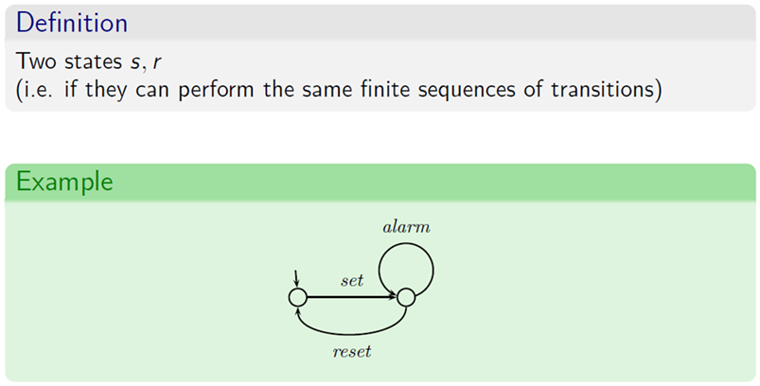
State Transition System

Slide 5
Bitcoin as a state transition system
world state
updated world state
UTXO₁
UTXO₂
⋮
UTXO₁
UTXO₃
⋮
input
…
…
Tx: UTXO₂ ⇾ UTXO₃
Bitcoin rules:
F_{bitcoin} : S × I ⇾ S
F_{bitcoin}: state transition function
S: set of all possible world states, s₀ ∈ S genesis state
I: set of all possible inputs
UTXO: Unspent Transaction Output
Courtesy Prof. Dan Boneh

Slide 6
Ethereum as a state transition system
Much richer state transition functions
⇒ one transition executes an entire program
Ethereum world state
updated Ethereum world state
input
…
…
Tx
Courtesy Prof. Dan Boneh

Slide 7
Running a program on a blockchain (DAPP)
… blockchain …
Tx1
Tx2
state₂
…
state₀
state₁
program code
create a DAPP
compute layer (execution chain): The EVM
consensus layer (beacon chain)

Slide 8
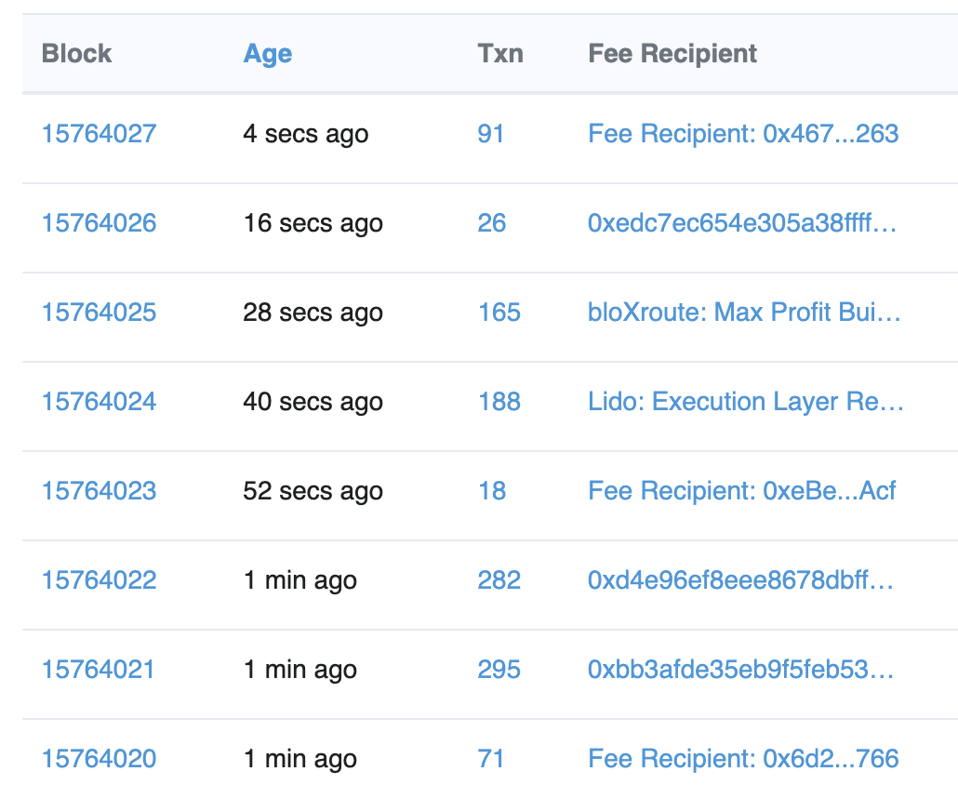
The Ethereum system
Proof-of-Stake consensus
One block every 12 seconds.
about 150 Tx per block.
Block proposer receives Tx fees for block
(along with other rewards)
Courtesy Prof. Dan Boneh
Notes:
https://etherscan.io/blocks

Slide 9
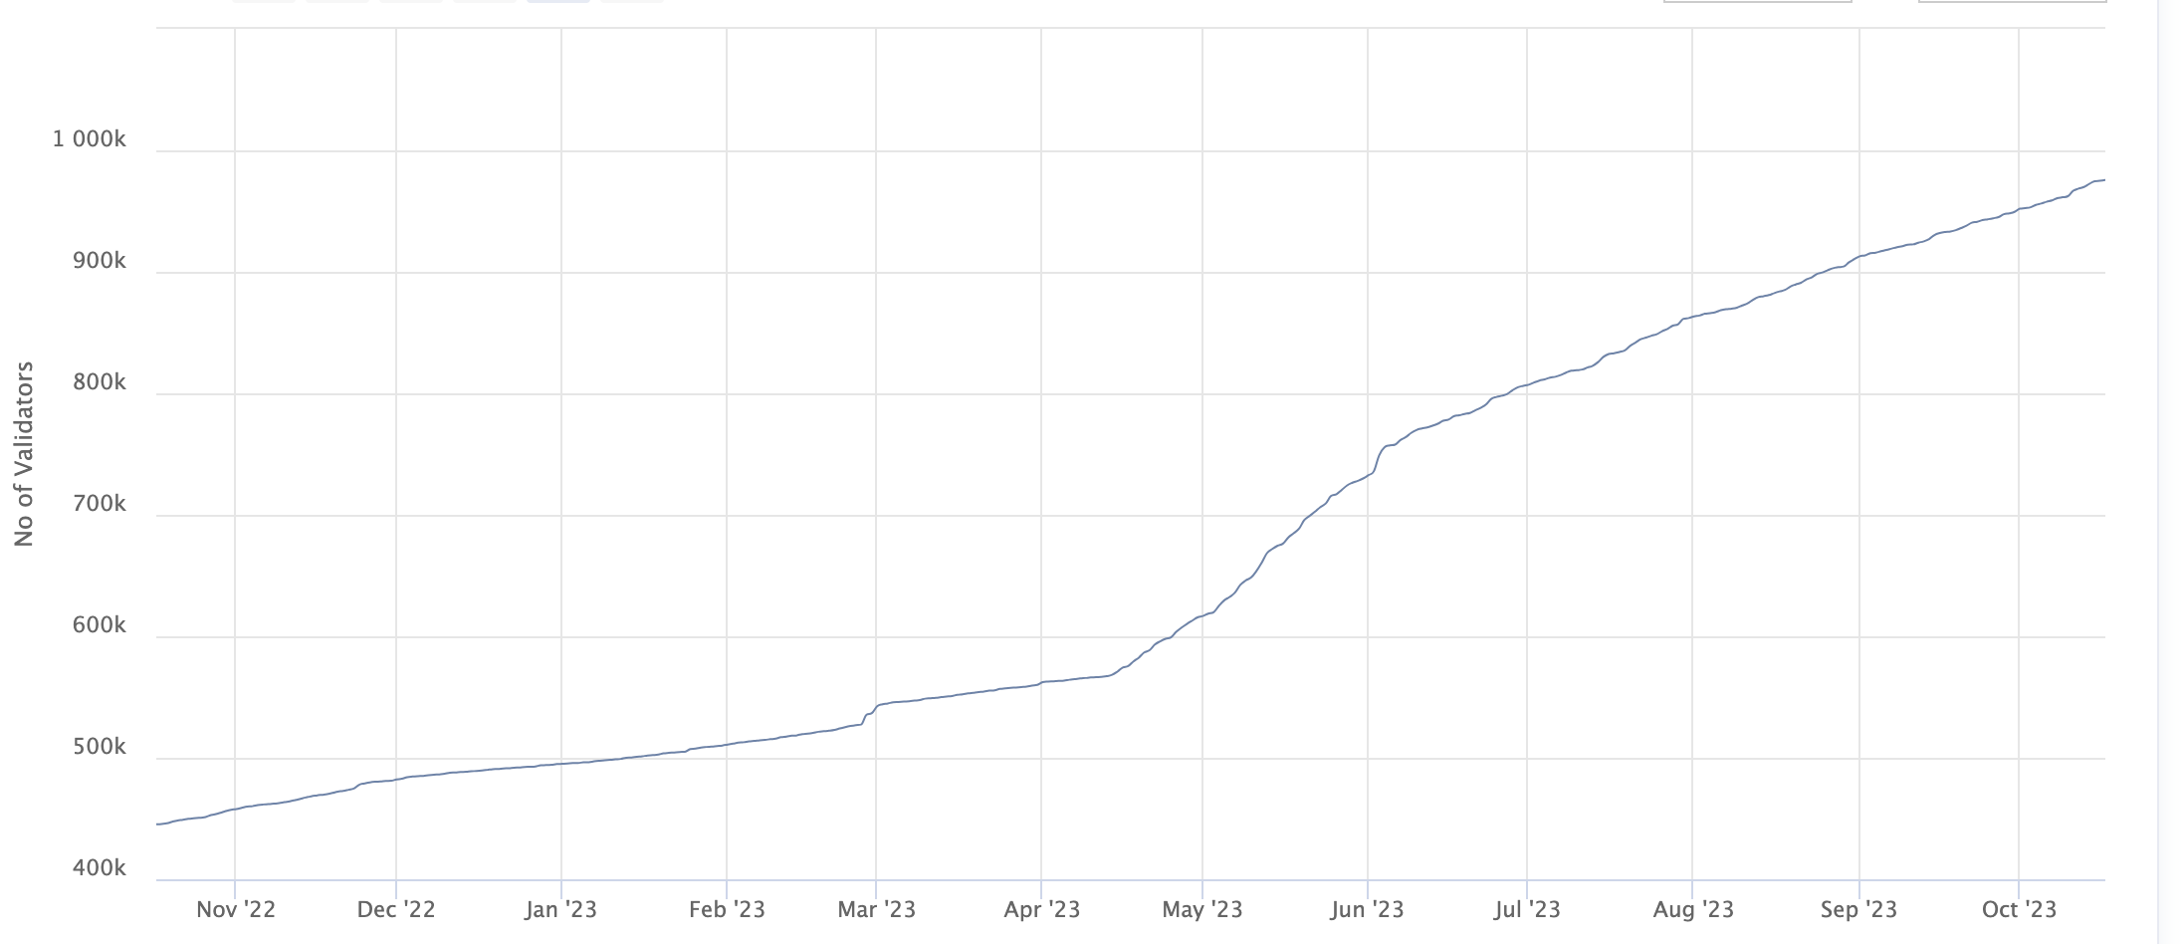
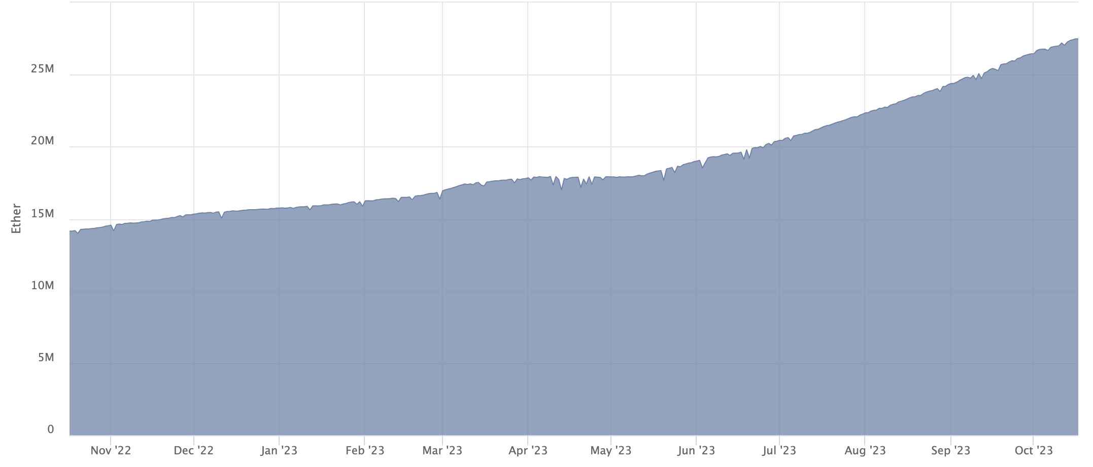
A bit about the beacon chain (Eth2 consensus layer)
To become a validator: stake (lock up) 32 ETH … or use Lido.
Validators: - sign blocks to express correctness (finalized once enough sigs)
- occasionally act as block proposer (chosen at random)
- correct behavior ⇒ issued new ETH every epoch (32 blocks)
- incorrect behavior ⇒ slashed
(lots of details)
Staked ETH
(27M)
# Validators
(843K)
Courtesy Prof. Dan Boneh
Notes:
https://beaconscan.com/stat/validator
Correct behavior: don’t sign two different blocks for same slot and other mischief.

Slide 10
The Ethereum system
update world state
compute layer (execution chain)
notify_new_payload(payload) [Engine API]
sends transactions to compute layer
1 slot = 12 secs
32 slots = 1 epoch
32 blocks in an epoch
consensus layer (beacon chain)
Courtesy Prof. Dan Boneh
Notes:
32 blocks make an epoch. Validators vote on blocks.

Slide 11
Ethereum compute layer: the EVM
World state: set of accounts identified by 32-byte address.
Two types of accounts:
externally owned accounts (EOA): controlled by ECDSA signing key pair (pk,sk).
sk: signing key known only to account owner
(2) contracts: controlled by code.
code set at account creation time, does not change
Courtesy Prof. Dan Boneh

Slide 12
Data associated with an account
Account data Owned (EOA) Contracts
address (computed): H(pk) H(CreatorAddr, CreatorNonce)
code: ⊥ CodeHash
storage root (state): ⊥ StorageRoot
balance (in Wei): balance balance (1 Wei = 10⁻¹⁸ ETH)
nonce: nonce nonce
(#Tx sent) + (#accounts created): anti-replay mechanism
Notes:
The computed address for a contract created with CREATE is H(CreatorAddr, CreatorNonce) as shown in the table above. Same when contract is created by an owned account. However, the computed address for a contract created with CREATE2 is H(CreatorAddr, InitCodeOfNewContract, Salt). This means that CREATE2 can be used to overwrite the code of a previous contract that resided in that address. This is only possible if the earlier contract did a SELFDESTRUCT. Either way, the nonce of a newly created contract is initialized to zero.

Slide 13
Account state: persistent storage
Every contract has an associated storage array S[]:
S[0], S[1], … , S[2²⁵⁶-1]: each cell holds 32 bytes, init to 0.
Account storage root: Merkle Patricia Tree hash of S[]
Cannot compute full Merkle tree hash: 2²⁵⁶ leaves
0
0, a
S[000] = a
S[010] = b
S[011] = c
S[110] = d
time to compute root hash:
≤ 2×|S|
0
0
⊥, b
root
1
1
10, d
1
⊥, c
|S| = # non-zero cells
Notes:
Store suffix in nodes. Ethereum’s Merkle Patricia Tree has a branching factor of 16.

Slide 14
State transitions: Tx and messages
Transactions: signed data by initiator
To: 32-byte address of target (0 ⇾ create new account)
From, [Signature]: initiator address and signature on Tx (if owned)
Value: # Wei being sent with Tx (1 Wei = 10⁻¹⁸ ETH)
Tx fees (EIP 1559): gasLimit, maxFee, maxPriorityFee (later)
if To = 0: create new contract code = (init, body)
if To ≠ 0: data (what function to call & arguments)
nonce: must match current nonce of sender (prevents Tx replay)
chain_id: ensures Tx can only be submitted to the intended chain
Courtesy Prof. Dan Boneh
Notes:
nonce must match current nonce of sender in sender’s account data. When Tx processed successfully, nonce in sender’s account data is incremented by 1.
chain_id: ensures that a Tx signed for the testnet cannot be submitting on the mainnet (same with L1/L2 confusion).

Slide 15
State transitions: Tx and messages
Transaction types:
owned ⇾ owned: transfer ETH between users
owned ⇾ contract: call contract with ETH & data
Courtesy Prof. Dan Boneh

Slide 16
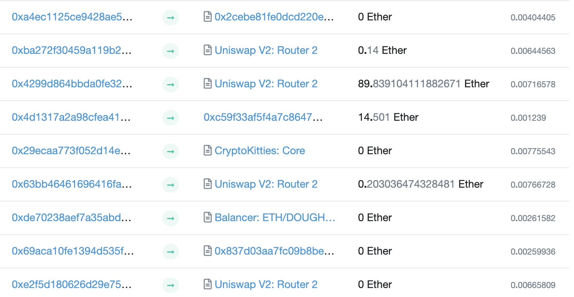
Example (block #10993504)
From
To
msg.value
Tx fee (ETH)
Courtesy Prof. Dan Boneh
Notes:
Some Tx go to contracts, others go to owned addresses

Slide 17
Messages: virtual Tx initiated by a contract
Same as Tx, but no signature (contract has no signing key)
contract ⇾ owned: contract sends funds to user
contract ⇾ contract: one program calls another (and sends funds)
One Tx from user: can lead to many Tx processed. Composability!
Tx from owned addr ⇾ contract ⇾ another contract
another contract ⇾ different owned

Slide 18
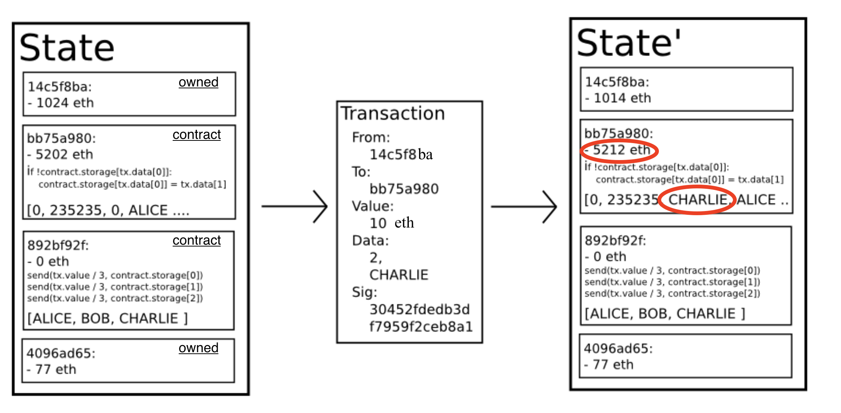
Example Tx
world state (four accounts)
updated world state

Slide 19
An Ethereum Block
Block proposer creates a block of n Tx: (from Txs submitted by users)
To produce a block do:
for i=1,…,n: execute state change of Tx_{i} sequentially
(can change state of >n accounts)
record updated world state in block
Other validators re-execute all Tx to verify block ⇒ sign block if valid ⇒ enough sigs, epoch is finalized.
Notes:
Other blockchains allow for non-interfering parallel execution: Flow, Avalanche.

Slide 20
Block header data (simplified)
consensus data: proposer ID, parent hash, votes, etc.
address of gas beneficiary: where Tx fees will go
world state root: updated world state
Merkle Patricia Tree hash of all accounts in the system
(4) Tx root: Merkle hash of all Tx processed in block
(5) Tx receipt root: Merkle hash of log messages generated in block
(5) Gas used: used to adjust gas price (target 15M gas per block)

Slide 21
The Ethereum blockchain: abstractly
prev hash
prev hash
…
…
accts.
accts.
updated world state
Tx
log messages
updated world state
Tx
log messages

Slide 22
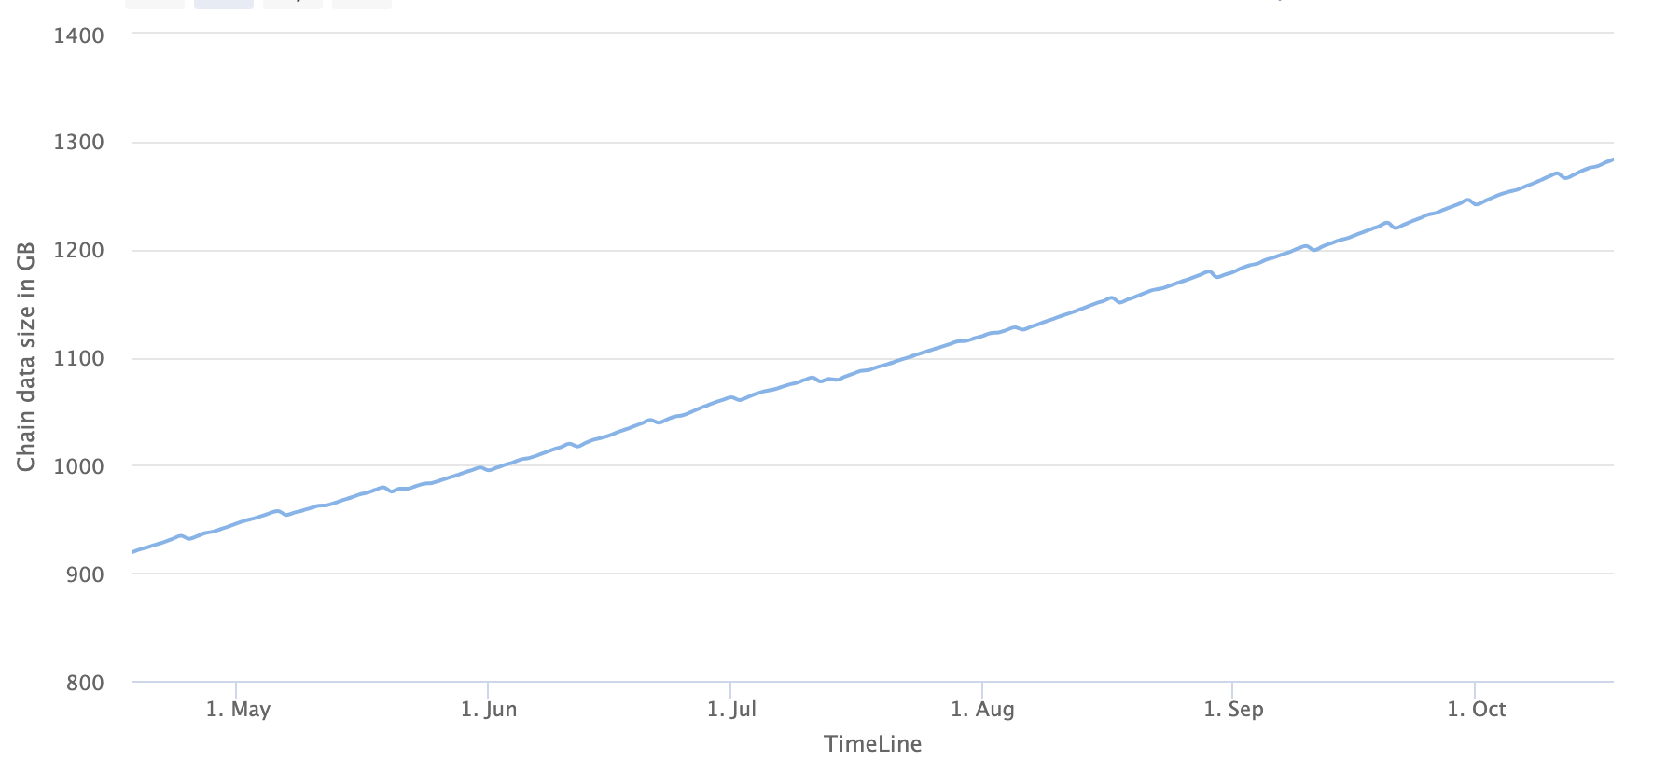
Amount of memory to run a node
≈1.3 TB
ETH total blockchain size (archival): 16 TB (Oct. 2023)
Notes:
https://etherscan.io/chartsync/chaindefault
https://etherscan.io/chartsync/chainarchive

Slide 23
EVM mechanics: execution environment
Write code in Solidity (or another front-end language)
⇒ compile to EVM bytecode
(some projects use WASM or BPF bytecode)
⇒ validators use the EVM to execute contract bytecode in response to a Tx
Courtesy Prof. Dan Boneh

Slide 24
The EVM
Stack machine (like Bitcoin) but with JUMP
max stack depth = 1024
program aborts if stack size exceeded; block proposer keeps gas
contract can create or call another contract
see https://www.evm.codes

Slide 25
Gas Calculation
Every block has a “baseFee”:
the minimum gasPrice for all Tx in the block
baseFee is computed from total gas in earlier blocks:
earlier blocks at gas limit (30M gas) ⟹ base fee goes up 12.5%
earlier blocks empty ⟹ base fee decreases by 12.5%
If earlier blocks at “target size” (15M gas) ⟹ base fee does not change
interpolate
in between

Slide 26
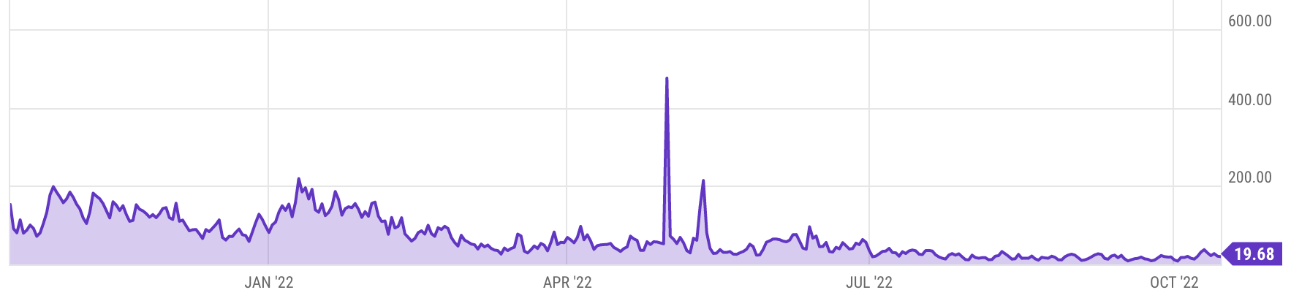
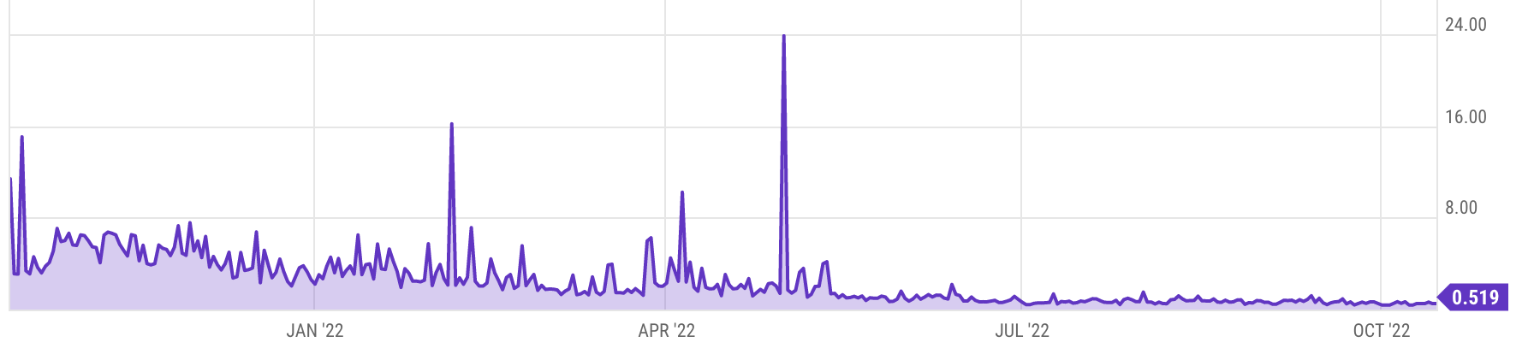
Gas prices spike during congestion
GasPrice in Gwei: 86 Gwei = 86×10⁻⁹ ETH
Average Tx fee in USD
congestion
Notes:
https://ycharts.com/indicators/ethereum_average_gas_price
https://ycharts.com/indicators/ethereum_average_transaction_fee

Slide 27
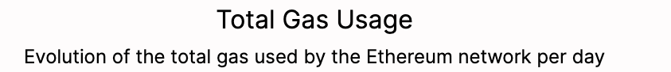
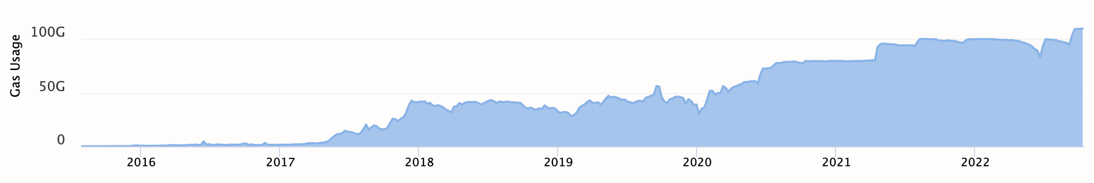
Note: transactions are becoming more complex
Gas usage is increasing ⇒ each Tx takes more instructions to execute
https://etherchain.org/charts/totalGasUsage
Notes:
https://etherchain.org/charts/totalGasUsage

